Slide 1

A Taste of Technology
April 10, 2023
Dawn Hudson (dawn.m.hudson@gmail.com)
Georgia Telecommunications Chair
President Georgia Beta Epsilon

Slide 2
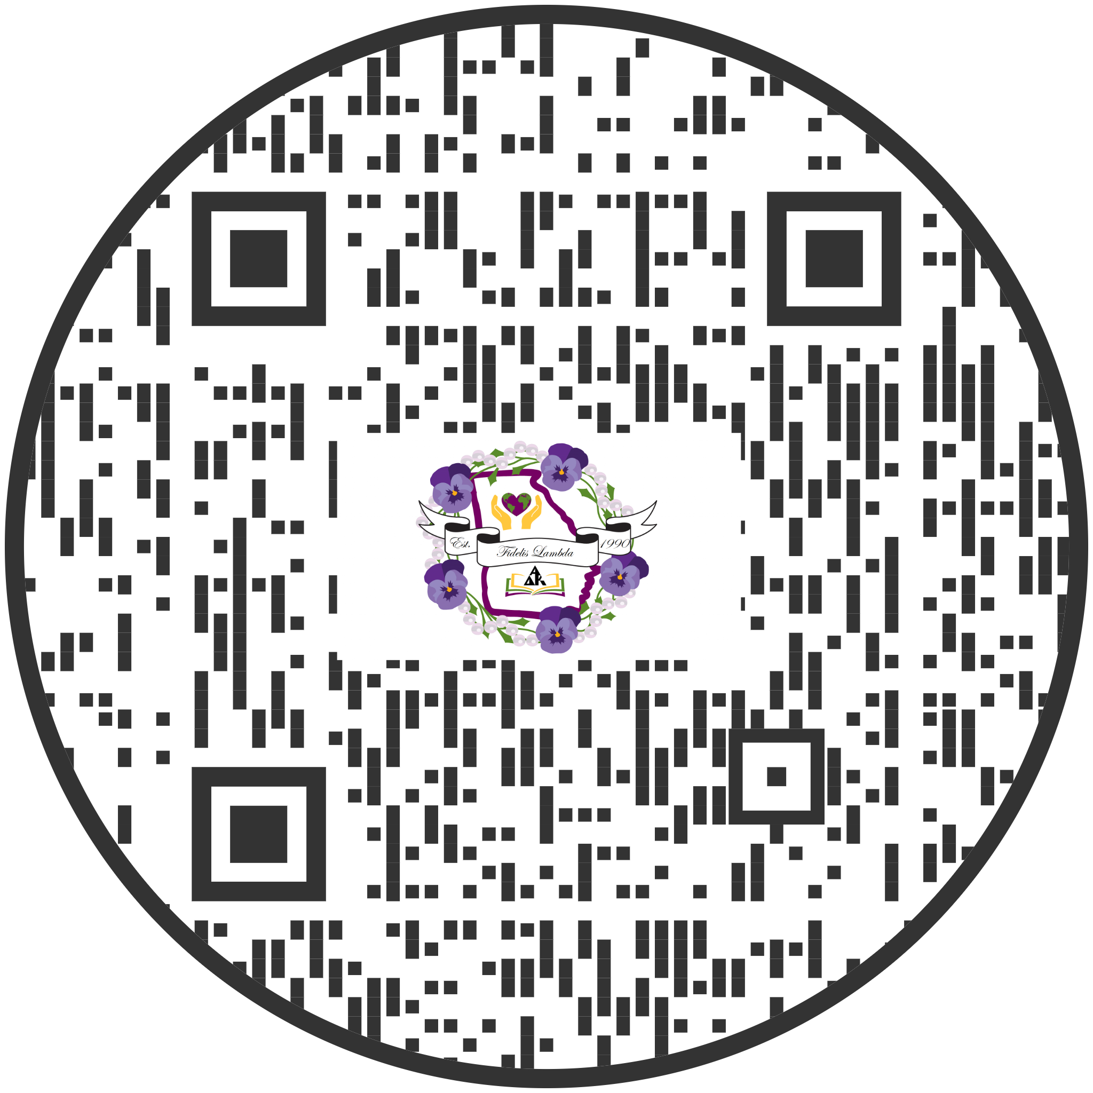
QR Code to Powerpoint and Materials
https://tinyurl.com/tasteoftech23

Slide 3
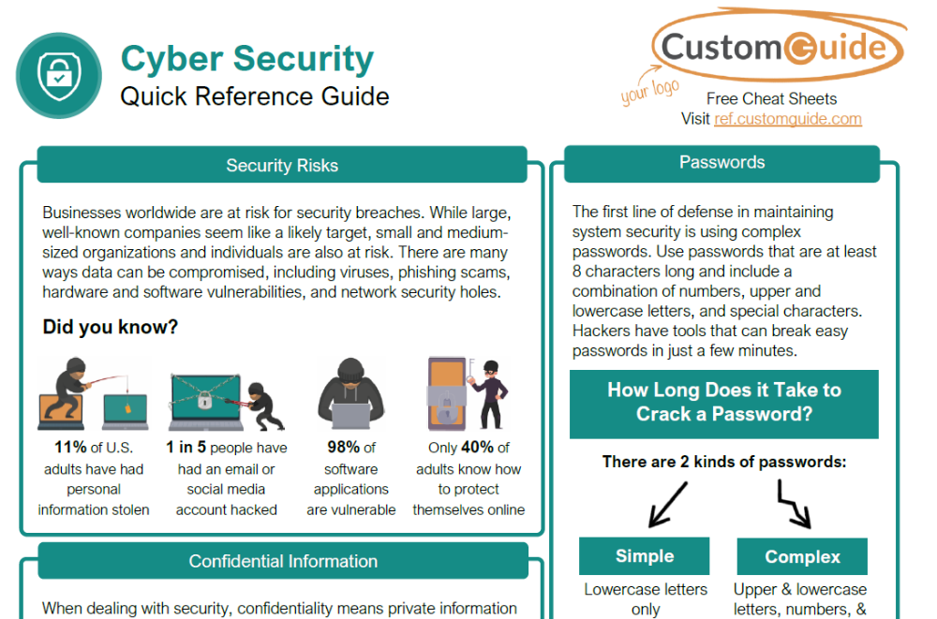
Cyber Security

Slide 4
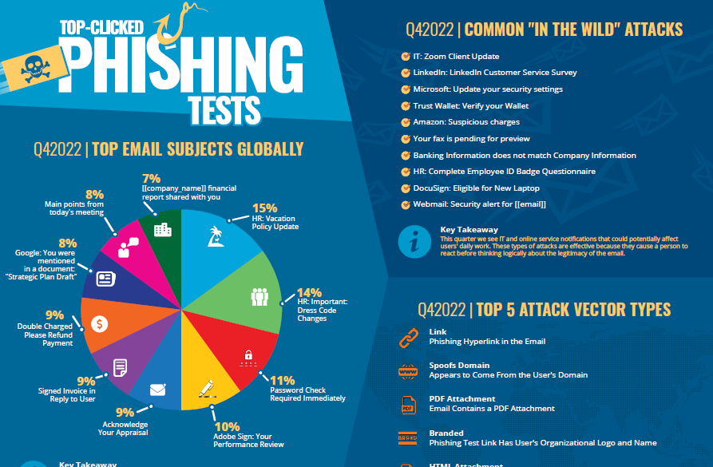
Top Clicked Phishing Tests

Slide 5

Google Scam Training
Google has created an excellent online training tool for scams which allows you to practice:
  https://phishingquiz.withgoogle.com/
If using online credit card, be sure there is https:// security with a padlock

Slide 6
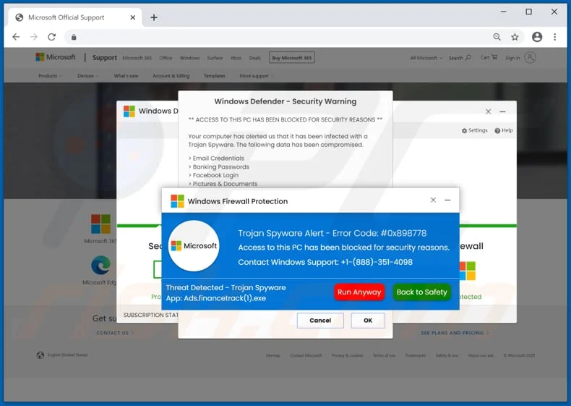
VIRUS! What to do?!

Slide 7
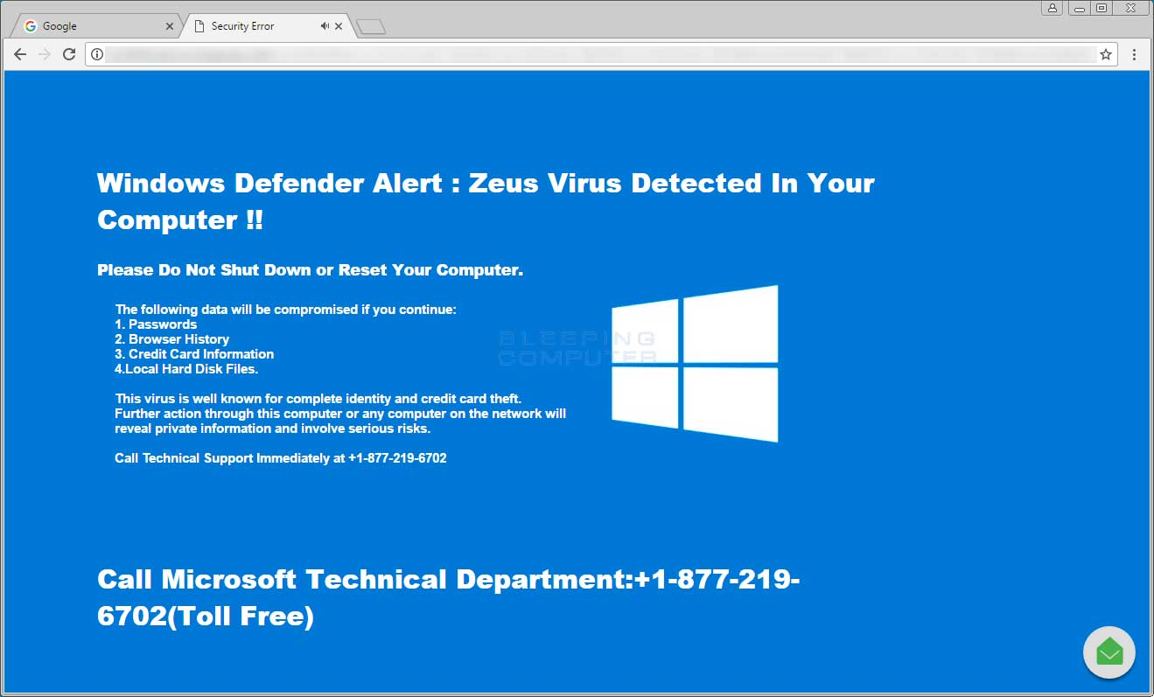
VIRUS! What to do?!

Slide 8
International Website
How to locate
  How to log in
  https://www.alphadeltakappa.org/
Handy Tip - put a shortcut to a specific page in your bookmark
  Directory Search: https://www.alphadeltakappa.org/ADKMembers/Members-Only/Directory/DirectorySearch.aspx?WebsiteKey=f0532a37-c465-40c9-a21d-b8a820867ef6&hkey=9e711432-2e12-4993-97b5-28316ffe29c6&a315d1c24e44=3#a315d1c24e44
  Resource Library (Search works here):
https://www.alphadeltakappa.org/ADK/ADKMembers/Members-Only/Resource-Library.aspx?hkey=0e7ab715-f886-4496-b47b-82efa28103a3

Slide 9
Georgia’s State Website
How to locate
  How to log in (only one page is locked with phone numbers and emails of GA Executive Board)
  https://gaalphadeltakappa.org/
Find Archived Newsletters
Find GA Past Presidents
Find Memorial Services
Find Chapter Officer Information

Slide 10
Free Technology Help Guides
Custom Guide: https://www.customguide.com/quick-reference
Includes quick “Cliff Notes” like versions for 84 various versions of Microsoft Office products, Google products, Windows products, and even general cyber safety.

Slide 11
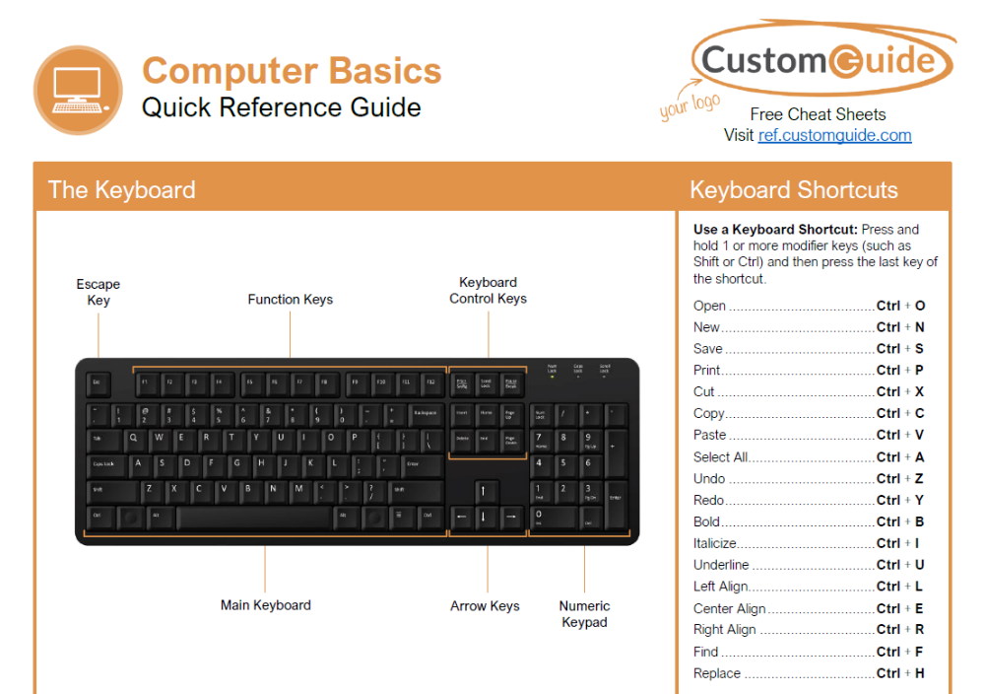
Computer Basics

Slide 12
Google - Gmail
Change settings so Gmail all goes into one tab vs. three (Inbox, Social and Promotions)
Change Gmail settings for how you read emails
  Threading/Conversation view (most people do not like this and it is the default setting)
  Individual email sorted by time view
Change subject when replying in a Gmail
Forward phishing emails to abuse@gmail.com

Slide 13
Computer Desktop Setup
Windows + H - Talk to type on computer
Microsoft Office Products (Word, Powerpoint, Excel, etc) Under “Help” , then “Show Training”
Names of parts of desktop - start button, system tray, taskbar, date and time, start menu, pinned apps

Slide 14
Word Tips
Use the paintbrush/roller to paint the format from one area to another (helpful for those times you cannot get the format correct on your own)

Slide 15
iPhone Tips
How to block texts and phone numbers - using the “i” information button
Shortcuts to typing a full email address - you create yourself such as gm = gmail address or bem = bellsouth email address
Shortcuts to turning on airplane mode, the flashlight
Four finger pull down for a phone search
How to turn on Face ID and which app(s) to allow it to be used

