Slide 1


Memorial Service ”Forever in our hearts”
Georgia Alpha Delta Kappa
Georgia State Convention
Sunday, May 19, 2024

Slide 2
processional
”Surely the presence of the lord is in this place”
Please Stand/Silence Your Phone

Slide 3
Opening thoughts
Robin Dudley
Georgia Alpha Delta Kappa Chaplain

Slide 4
Special Music
“Coming Home”
Cathy Limmer, Georgia - Music Chairman
Jeannie Butler – Pianist
Georgia Alpha Delta Kappa Choir

Slide 5
Eulogies for Past State and International Presidents

Slide 6
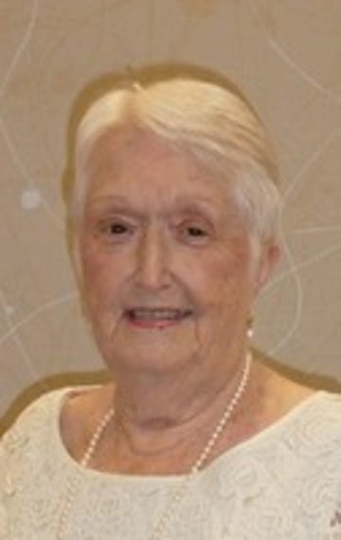
Melba Priestley
Past International President
(1995-1997)
Past State President
(1984-1986)
Alpha Gamma Chapter
  Remembered by:
  Debbie Boswell
  Georgia President 2022-2024
  and
  Ann Hudson
  Past International President 2007-2009

Slide 7
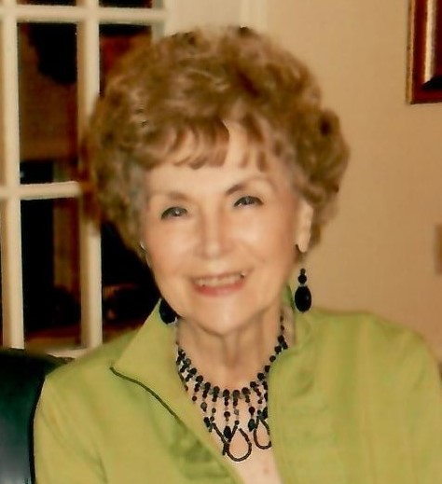
Audrey Brown
Past State President
(1988-1990)
Alpha Delta Chapter
  Remembered by:
  Hazel Stanton
  Past State President 2006-2008

Slide 8
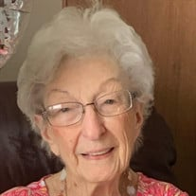
Dorothy “Dot” Youngblood
Past State President
(1992-1994)
Alpha Beta Chapter
Remembered by:
Debbie Clark
Past State President 1984-1986

Slide 9
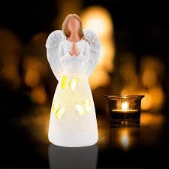
Memorial Candle
“
“Remember Me….Celebrate My Life”
Robin Dudley, Chaplain

Slide 10
Special Music
“His eye is on the sparrow”
Cathy Limmer, Soloist
Music Chairman

Slide 11
Remembrance
Omega Chapter
2022-2024
Georgia District Chairman

Slide 12
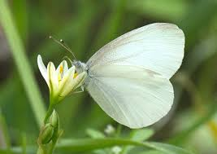
Albany District
Lori Carnine

Slide 13
Albany District 2022-2024
Members of the Omega Chapter
Pat Bush – Alpha Rho
Willette Ensley – Alpha Rho
Serena Murphy – Alpha Rho
Martha Hill – Beta Rho
Allawee Gaggstatter – Beta Rho
Dorothy Mayo- Beta Rho
Janet Forrester – Fidelis Alpha

Slide 14
Athens District
DonnA Smith

Slide 15
Athens District 2022-2024
Members of the Omega Chapter
Naomi Cockerham – Beta Delta
Ramona Nichols – Beta Delta
Debbie Nicholson – Beta Delta
Dr. Vida Rogers – Beta Eta
Karen Poole – Gamma Delta
Birdie Craft – Fidelis Nu
Edell Raburn – Fidelis Nu
Ruth Parten – Fidelis Xi

Slide 16
Atlanta District
Erin Neal

Slide 17
Atlanta District 2022-2024
Members of the Omega Chapter
Kathy Lobe – Alpha
Melinda Thompson – Gamma
Jeanette Williford – Gamma
Lynne Beth Caldwell – Delta
Sara Deiters - Delta
Renee Gaither – Phi
Frances Lunsford – Chi
Beth Walker – Chi
Gayle Harvil – Alpha Tau
Mary Walker – Alpha Tau
Helen Lenkerd – Beta Gamma
Pat Mosley – Beta Gamma

Slide 18
Augusta District
Angela Hobby

Slide 19
Augusta District 2022-2024
Members of the Omega Chapter
Lois Akins – Omicron
Mary Yeomans – Omicron
Barbara Jean Petty – Alpha Epsilon

Slide 20
Columbus District
Pat Smith

Slide 21
Columbus District 2022-2024
Members of the Omega Chapter
Samie Lott – Beta Theta
Cynthia Estes – Beta Iota
Ellen Partridge – Beta Iota
Murbes Shepherd – Beta Iota

Slide 22
Dalton District
Shannon Cole

Slide 23
Dalton District 2022-2024
Members of the Omega Chapter
Millicent Smith – Kappa
Lou Warren – Kappa
Audrey Brown – Alpha Delta
Past State President 1988-1990
Phyllis Purdy – Alpha Lambda
Mary Beth Smith – Gamma Beta

Slide 24
Decatur District
Melissa Kinard
Penny clavijo

Slide 25
Decatur District 2022-2024
Members of the Omega Chapter
Deborah Upchurch – Beta
Elizabeth Hendricks – Alpha Eta
Cenci Suber – Alpha Eta

Slide 26
Golden Isles District
Jewel Hendrix

Slide 27
Golden Isles District 2022-2024
Members of the Omega Chapter
Linda Reddick – Alpha Beta
Dorothy Youngblood – Alpha Beta
Melba Priestley – Alpha Gamma
Past State President 1984-1986
Past International President 1995-1997
Florene Hendrix – Alpha Gamma
(Honorary Member)
Lanna Denison – Beta Xi

Slide 28
Heart of Georgia District
Barbara Long

Slide 29
Heart of Georgia District
2022-2024
Members of the Omega Chapter
Heart of Georgia had no Members join the Omega Chapter in the 2022-2024 Biennium

Slide 30
Marietta District
SHeilA mILLER

Slide 31
Marietta District
2022-2024
Members of the Omega Chapter
Julia Kidd – Alpha Alpha
Patricia Tillman – Alpha Pi
Ruthann Butscher – Alpha Sigma
Frances Giles – Alpha Sigma
Sandra DeRose – Fidelis Lambda

Slide 32
Sustaining Members

Slide 33
Sustaining Members
2022-2024
Members of the Omega Chapter
Georgia had no Sustaining Members join the Omega Chapter in the 2022-2024 Biennium

Slide 34
Athens District 2022-2024
Members of the Omega Chapter
Alpha Delta Kappa
Association
Glenn Kesler

Slide 35
Special Music
“A Prayer for every day”
Kathy Lemmer, Georgia - Music Chairman
Jeannie Butler – Pianist
Georgia Alpha Delta Kappa Choir

Slide 36
Benediction

Slide 37
Recessional
Please Stand and Follow Sergeant-at-Arms Directions

Slide 38
Butterfly release

